Slide 1
Independent Project
Entity Extraction From Job Ads, CV and Skill Gap Analysis
Guide: Prof. Mukesh Mohania
Naman Tyagi (2018055) | Sanchit Trivedi (2018091) | Shashwat Aggarwal (2018097)

Slide 2

Motivation (1/2)
Given a job advertisement, we often would like to know whether or not we are a fit candidate for the given job ad.
Getting useful insight into the required skills for the job is important to improve chances of a candidate getting selected for the job.
This requires semantic information about jobs such as MySQL and Database are closely related; however, Java and JavaScript are entirely different languages.
Furthermore, even more, important than hard skills are the soft skills required for any job

Slide 3

Motivation (2/2)
.
As we are about to enter the job market, it is important for us to get insight into jobs and find gaps in our skill sets to improve our chances to secure a good job.
We aim to extract technical skills and soft skills from job advertisements. Using semantic relations and practical similarities between skills, we will provide skill gaps between the required skills and the candidate’s skills.
This will even enable recruiters to shortlist candidates in more meaningful method versus current systems such as shortlisting on basis of grades or recommendations.

Slide 4
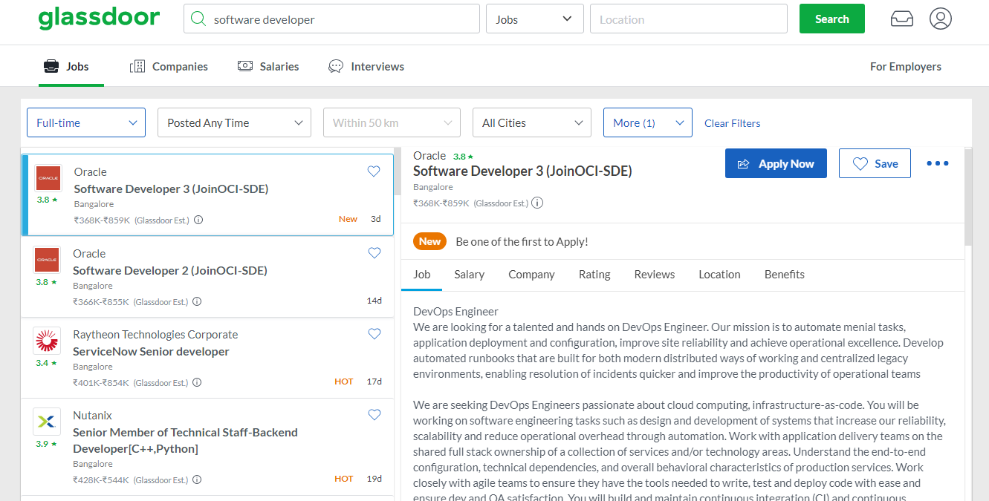
Dataset
Job Advertisements - Scraped 300 software development job ads. Data headers included Company name, Job Title, Job Description, Job Location and Salary.
Resumes - We used a dataset from Kaggle (Link) which contained the skills of the applicant

Slide 5
Methodology (1/3)
1. Skillset Phrase Matcher
Initialised a dictionary of skills containing over 8000 significant skills in the software and technical domain.
Generated a phrase matcher to process and extract skills from this dictionary. Using spacy, build a model to extract the skills from job description and resume skills.
2. Preprocessing and Extracting Skills from Job Description
The job description is in an inconsistent format. There was no consistent demarcation between various sections of the job description.
This job description was pre-processed to remove stopwords and then lemmatised using the Spacy library.
The skills required for the job description were extracted using the skill phrase matcher by parsing the preprocessed job description.

Slide 6
Methodology (2/3)
3. Skill2Vec Model
The Skill2Vec model is an unsupervised pre-trained model trained on 1.4 million job descriptions using Word2Vec.
It gives the cosine similarity between 2 words which is the metric that we will use to find thresholds for various further steps. The Skill2Vec model has reported an accuracy of 78% on its dataset.
4. Skill Transform
Implemented a skill_transform function inspired by Skill2Vec. This is a helper function for the model to incorporate patterns not recognised by the word embeddings.
It helps solve inconsistencies in the model by encoding various similarities and differences in the meaning of multiple skills. E.g., OOPs and Object-Oriented Programming are the same.

Slide 7
Methodology (3/3)
5. Gap Analysis
Gap Analysis is performed by measuring the cosine similarity between the feature vector of the candidate skills with each skill in the job description.
If the score returned is smaller than the supplied threshold, the skill is considered to be absent in the candidate’s skill set and is returned as a skill gap between the candidate and the job.
6. Soft Skills
Each Job Description is a multi class label out of three soft skills - Problem Solving, Teamwork and Leadership.
The label is assigned by calculating the cosine similarity between the job description and the feature vector of the words similar to each soft skill.
If the value is greater than a particular threshold, the job description is assigned the label of that soft skill.

Slide 8
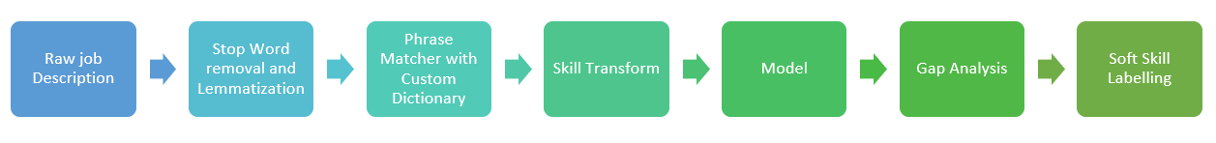
Flow Chart

Slide 9
Result
To test our model we manually annotated the prepared dataset and assigned multi-class labels of Leadership, Teamwork and Problem Solving. This was then compared with the predictions from our model.
For validating the skill gap analysis produced by our model we again manually annotated the dataset with the expected skills gaps. The gaps are annotated as the skills which the candidate does not satisfy from the job skills.
Type/Metric | Soft Skills | Skill Gap
Accuracy | 0.6923 | 0.6342
Precision | 0.7344 | 0.6727
Recall | 0.6410 | 0.7772

Slide 10
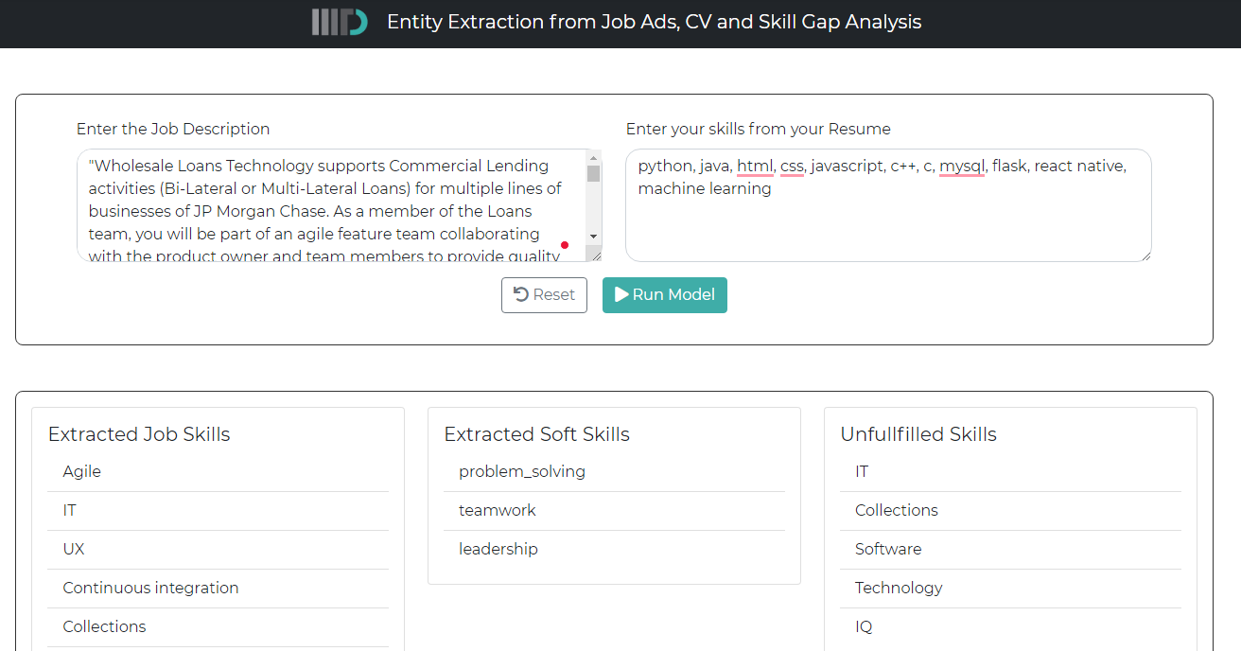
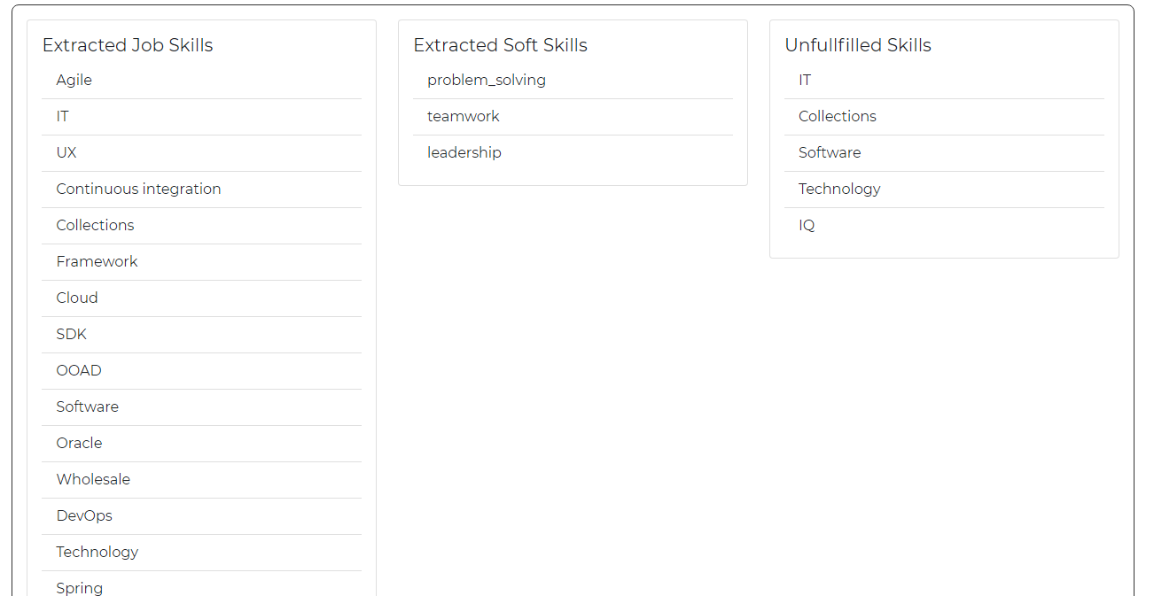
Demo [Link]

Slide 11
References
Van-Duyet, L., Quan, V. M., & An, D. Q. (2017). Skill2vec: Machine learning approach for determining the relevant skills from job description.
Honnibal, M., & Montani, I. (2017). spaCy 2: Natural language understanding with Bloom embeddings, convolutional neural networks and incremental parsing.
Ahmed Awan, M. N., Khan, S., Latif, K., & Khattak, A. M. (2019). A new approach to information extraction in user-centric E-recruitment systems. Applied Sciences (Basel, Switzerland), 9(14), 2852.
Mikolov, T., Chen, K., Corrado, G., & Dean, J. (2013). Efficient estimation of word representations in vector space.
Kalva, T. R. (n.d.). Skill finder: ASkill finder: Automated job-resume matching system automated job-resume matching system.

